Slide 1

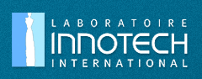

Involvement of a pharmaceutical company in tracking of drugs side effects during clinical trials
François VERRIERE
MEDICAL AFFAIRS DIRECTOR
INNOTECH INTERNATIONAL
ALMATY - 17th April 2014
Notes:
Mr President, Dear Colleagues …
I am delighted to be with you today in Almaty, with the opportunity to present you some information relatad to the operational involvement of my pharmaceutical company in the tracking of drugs side effects during clinical research

Slide 2

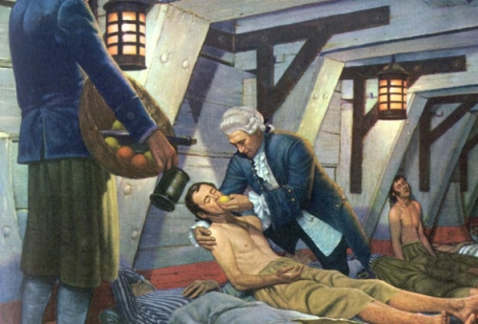
CLINICAL RESEARCH :
Already Dr Lind in 1753 …
The 1st comparative clinical study published in 1753
was conducted by Dr Lind (Surgier in the Royal Navy)
in prevention of scurvy (Acute Vitamin C deficiency)
among sailors :
One treated group : lemon juice
One control group : vinegar solution
2
2
Notes:
To introduce this presentation, I should say that at the beginning of clinical research the unique objective was the efficacy side, with regards to the public health priorities at that time.
For example, in 1753, Dr Lind who published the first article on a comparative study in prevention of scurvy in sailors with citrus intakes was more motivated to demonstrate the efficacy rather than to highlight any problem of safety of the treatment.

Slide 3
PRELIMINARY STATEMENTS :
The essential benefit / risk ratio
Two phases, according to the drug life cycle :
Development phase :
  Efficacy and Safety = Pivotal clinical data
Post marketing phase :
  Efficiency = Supportive clinical data
  Safety = Pharmacovigilance
      The benefit/risk ratio is never
      definitive and must be constantly reassessed
      Pharmaceutical companies are in first line in
      the assessement of the benefit / risk ratio
Notes:
I propose you now to review some preliminary statements :
The first statement is related to the central issue in assessing correctly the benefit / risk ratio of a treatment.
In the past, this benefit ratio was roughly assessed during the developpment period and was not modified, except the occurrence of any obvious problem of safety
It is no longer possible to do not take in account the differences between the patient exposure during the developement period and patient exposure in real condition of the of the drug
This benefit risk ratio must be constantly reassessed, from the development period with the data from pivotal clinical studies, up to the pharmacovigilance and the postmarketing surveillance
However the benefit ratio is never definitive and must be constantly reassessed and the key data for assessment are clinical

Slide 4
PRELIMINARY STATEMENTS :
The essential benefit / risk ratio
 | Clinical development | Post Marketing period
Patient exposure | Limited | Large
Drug use | Under conditions of a protocol | Real conditions of use
At-risk patients | Healthy (apart the indication) | Large, including at risk groups
Efficacy assessment | Pivotal (clinical and statistical evidence ) | Supportive only
Safety assessment | Suggestive only | Pivotal (real conditions of use)
Could the suggestive clinical development period be predictive ?
4

Slide 5
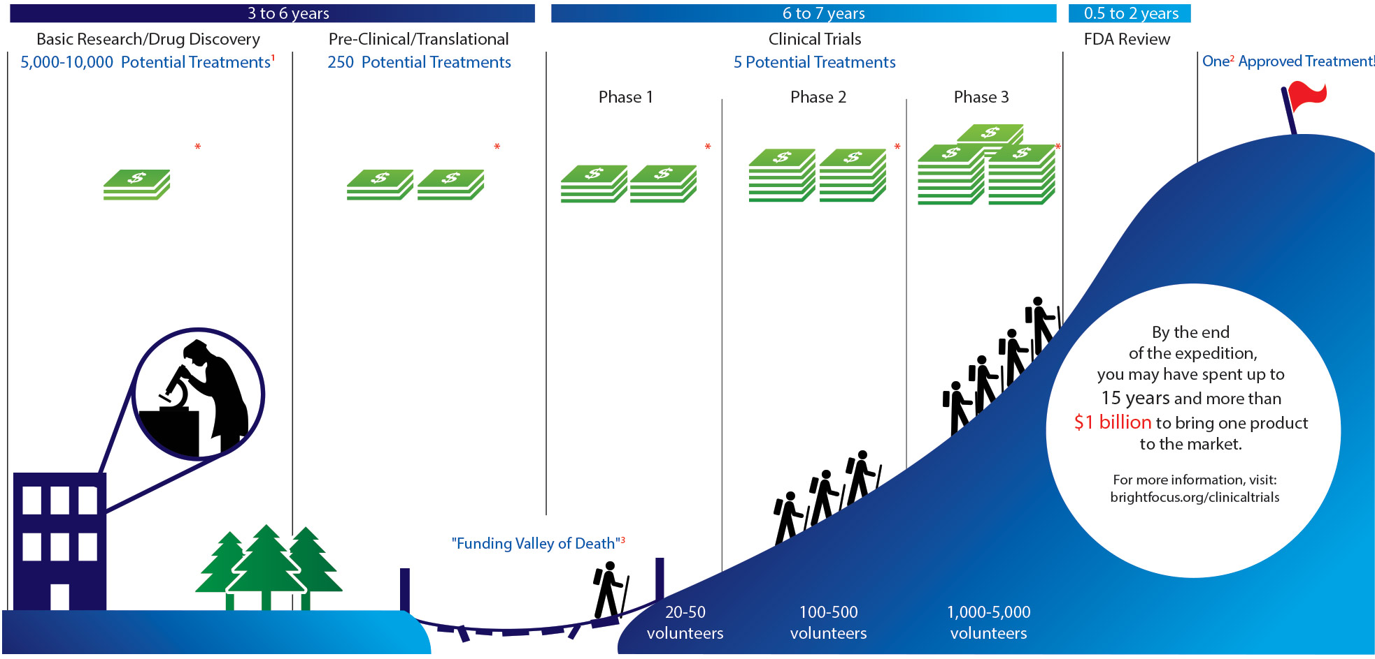
PRELIMINARY STATEMENTS :
Early detection of safety issues
Paradox :
Sponsors wish an early assessment of safety (costs)
But reliable detection requires a high number of patients
5
Notes:
The third statement

Slide 6
TRACKING DRUG SIDE EFFECTS
DURING CLINICAL TRIALS
Patient exposure
Adverse Events (AE)
Safety data
collection
Operational ICSR*
management
Patient protection
Risk management
Global risk
Early signal detection
Extrapolation of safety results
From individual to collective patient protection
* = Individual Case Safety Report

Slide 7
TRACKING DRUG SIDE EFFECTS
DURING CLINICAL TRIALS
    Operational ICSR management
    Risk management
    Extrapolation of safety results
7

Slide 8
TRACKING DRUG SIDE EFFECTS
DURING CLINICAL TRIALS
    Operational ICSR management
    Risk management
    Extrapolation of safety results

Slide 9
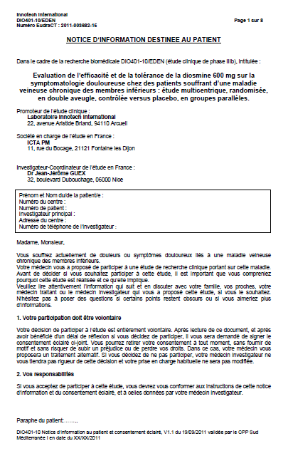
Operational ICSR management :
What are the stakeholders ?
The patient (and relatives) :
- Written informed consent form :
- To ensure the awareness and the acceptance of the safety risk
- To inform about insurance process
- To optimize patients compliance (instructions)
- Patient’s reporting tools :
  - Self assessment book / leaflet to facilitate spontaneous notifications and to get early primary information tracability (clock start)
- Phone monitoring

Slide 10

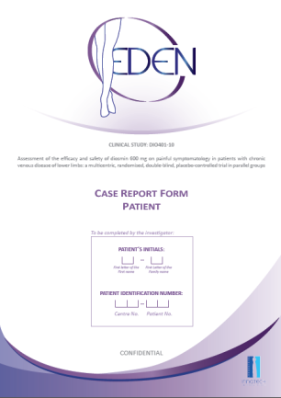
Operational ICSR management :
What are the stakeholders ?
2) The investigator :
- Keeps in touch with the patient :
  At least during regular visits planned
  In case of any incoming adverse event
- The case report form :
- To get written confirmation and to confirm the clock start
- To get a primary assessment on site (severity + seriousness + causality / relatedness)
- The investigator’s brochure (or SmPCs) :
- To prevent adverse events occurrence (respect of contra indications, interactions …)
- To differenciate labelled / not labelled AE
Notes:
L4INVESTIGATEUR PREVEINT LE RISQU EN COMPLIANT STRICTEMENT AU PROTOCOLE 5RESPECT DES CRITERES D4INCLUSIONS ET D4EXCLUSION

Slide 11
Operational ICSR management :
What are the stakeholders ?
2) The investigator :
- Investigator’s reporting to Sponsor timelines depends
on the seriousness assessment :
- Reporting to Sponsor depends :
- Neither on Severity / Intensity
- Nor on Causality / Relatedness
- Nor on Expected / Labelled status
Yes = The investigator reports immediately (<24h)
No = The investigator reports in the CRF
Seriousness
Seriousness = outcome
- Death
- Life threatening
- Hospitalization or prolongation
of hospitalization
- Significant disability or defect
- Congenital anomaly or birth
defect
11

Slide 12
Operational ICSR management :
What are the stakeholders ?
But this on site role induces risks of inconsistencies :
- Under-declaration of SAEs due to wrong interpretation of the investigator in the seriousness / non-seriousness status
- Unexpected increase of frequency of non serious AEs or expected serious SAEs (not reported immediately) can be delayed in reporting
Some recommandations :
- Frequent monitoring on site
- e-CRF to replace paper based reports
- Continuous data management
- Early medical review
12

Slide 13
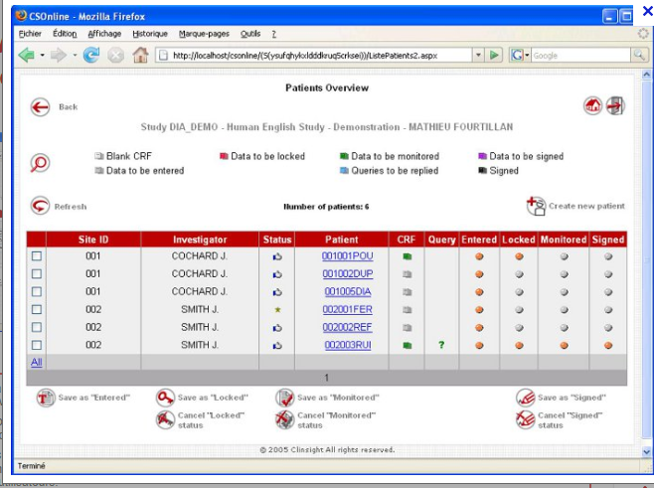
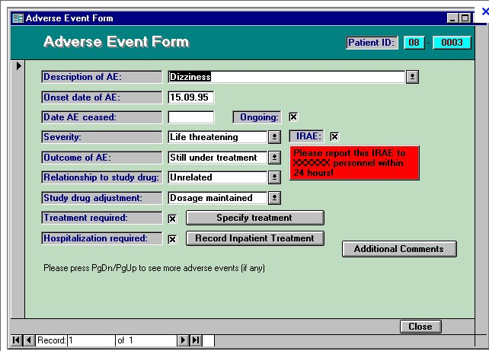
Operational ICSR management :
What are the stakeholders ?
Pivotal interest of e-CRF :
Immediate links betwen investigation site and sponsor
Immediate alert in case of SUSAR
Sponsor confirmation of SUSAR / non SUSAR status
No delay in data management and medical assessment
No monitoring delay in case of inconsistant information
Continuous assessment of safety issues not depending on monitoring plannings
13

Slide 14
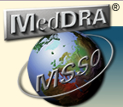
Operational ICSR management :
What are the stakeholders ?
3) The monitoring and data management staff :
- Investigators training to help in reporting of ICSR
- Validation on site the primary information (source)
- Prevention of missing data
- Use of a validated coding process
- Delivery a reliable safety database
- Edition of case reports, line listings and queries
- Certification of the tracability and the quality
(standard operating procedures)
Reliable data are the raw material for risk management
14

Slide 15
TRACKING DRUG SIDE EFFECTS
DURING CLINICAL TRIALS
    Operational ICSR management
    Risk management
    Extrapolation of safety results

Slide 16
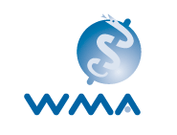
Risk management :
The protections of persons
From an ethical point of view :
It is easy to assess the efficacy
It is less easy so assess the safety
A prerequisite to safety assessment :
Individual patient interest > collective interest
Information of the patient on risk and consent process
Anticipated management of risk
Ethical clearance of independant committees
Liability of the sponsors (Insurance)
*
16
* World Medical Association
Notes:
The second statement is related to the protection of persons
In the past, this benefit ratio was roughly assessed during the developpment period and, except the occurrence of an obvious problem of safety, there were no real reassessment after market authorization
it is no longer possible to do not take in account the differences between the patient exposure during the developpement period and patient exposure in real condition of the of the drug
This benefit risk ration must be constantly reassessed, from the developpment period with the data from pivotal clinical studies, up to the pharmacovigilance and the postmarketing surveillance
However the benefit ratio is never definitive and must be constantly reassessed and the key dat for assessment are clinical

Slide 17
Risk management :
What are the stakeholders ?
4) The Pharmacovigilance Qualified Person :
- To assume sponsors responsabilities with regards to
regulatory requirements and timelines
- To monitor the workflow of all occurring ICSR from
data management up to medical assessment
- To declare to Health Authorities and Ethics Committee
- To detect any signal :
  - Unexpected / not labelled Serious AE (SUSAR)
  - Increase in frequency of a labelled AE
Pharmacovigilance activity must be independant of the management of the trial
17

Slide 18
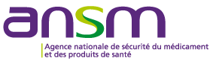

Risk management :
What are the stakeholders ?
Who is the qualified person ?
National level (Headquarters in France):
  QPPV (Under delegation from QP)
  Deputy QPPV (Back-up)
European Union level for EMA / Eudravigilance (Headquarters in France):
  European Union Qualified Person in Pharmacovigilance (EUQPPV)
  Deputy EUQPPV (Back-up)
International level: Contact person in headquarters for Pharmacovigilance activities (no regulation)

Slide 19
Risk management :
What to declare and timelines ?
To Health Authorities and Ethics Committee :
Developement Safety Update Report = DSURs
Suspected Unexpected Serious Adverse Reaction (SUSARs) and new safety information :
  - National and Europe agencies
  - All countries where the study is conducted
Declaration to HA and Ethics committee |  | Seriousness
 |  | Yes | No
Expected / Labelled | Yes | Line listing once a year* / DSUR | Line listing once a year* / DSUR
 | No | < 7 days for death or lifethreatening < 15 days for other SAE | Line listing once a year* / DSUR
* Every 6 months in France

Slide 20
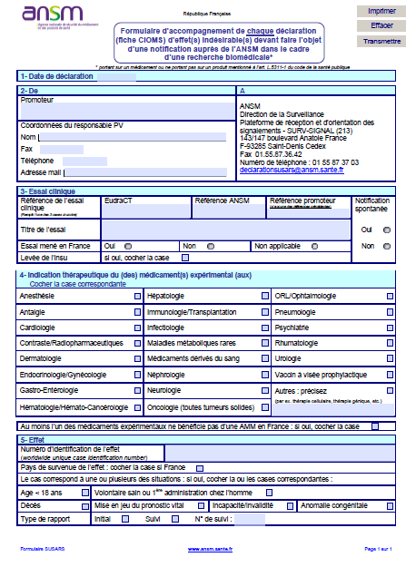
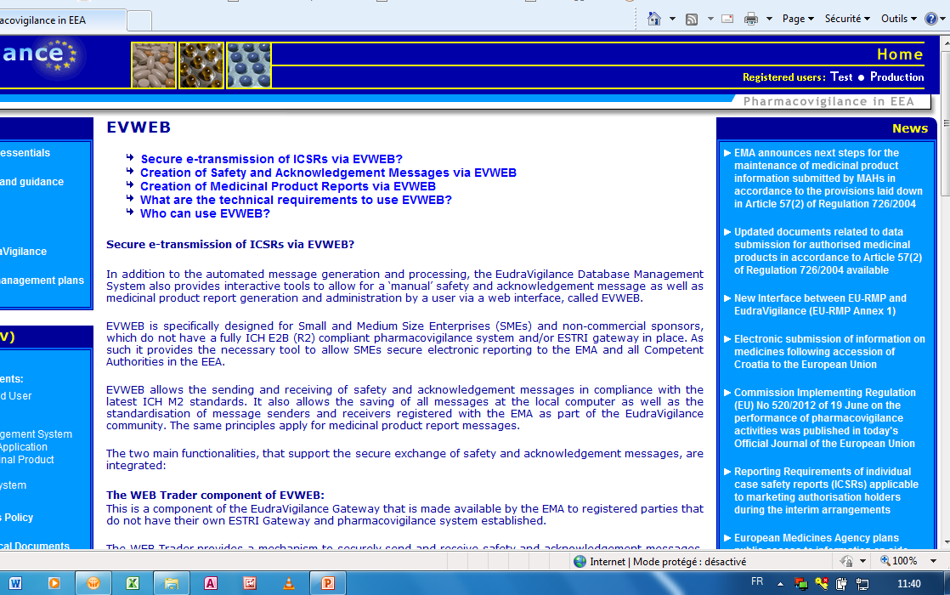
Risk management :
How to declare SUSARs ?
Initial SUSARs declarations and follow-up declarations :
To ANSM : Form sent by mail
To EMA (EudraVigilance) :
- e-declaration xml if sponsor
has a validated data base
- Gateway EVWEB if not
20

Slide 21
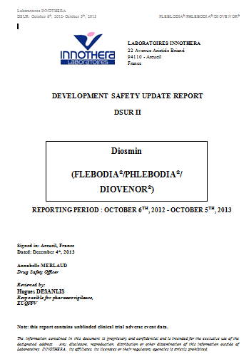
Risk management :
Interest of DSURs ?
Development Safety Update Reports (ICH harmonized):
- Corresponds to PSURs in clinical development
- Merges and cumulates all studies conducted with the same active substance
Includes PSURs data in case of postmarketing studies
Matches qualitative and quantitative analysis to patient exposure
DSURs = declarative reports of safety data but not a risk management
DSURs = regular confirmation of Health Authorities and Ethical committee clearances

Slide 22
Risk management :
What are the stakeholders ?
5) The Medical Assessor (Sponsor side):
- To validate / to check each incoming ICSR :
- Consistencies, narratives, completion
- Status (seriousness, relatedness) …
- To assume permanently the individual benefit / risk
ratio of patients included
- To treat any generated signal
- To update permanently the management of risk (i.e.
Investigator’s brochure)
The medical assessor represents the company position in assessment of risk
22

Slide 23
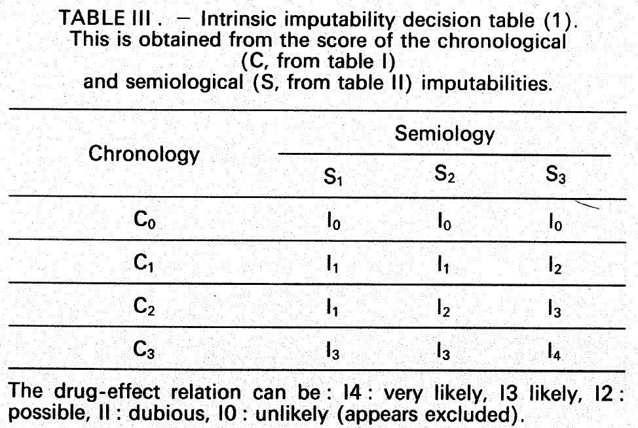
Relatedness assessment :
Which method ?
- The French method* used in postmarketing pharmacovigilance is not appropriate :
  - Chronological (Challenge, dechallenge and rechallenge)
  - Semiological (Suggestive or not suggestive and existing alternative explanation)
- Subjective assessment confirmed by sponsor but risk in :
  Inducing parasitic noise and false positives
  Reducing rates of reliable positive signals
B. Bégaud et al : Unexpected or toxic drug reaction assessment (imputability) Therapie, 1985, 40: 111 - 118
Notes:
What is the aim of the French method of causality assessment ?
To summarize, it is a more objective method, crossing two kinds of criteria :
Firstly a chronological criteria, in particular the challenge and dechallenge. I mean for example the occurrence of the Adverse reaction at the exact beginning of the patient exposure to treatment and the disapearance of the same adverse reaction just after the end of patient exposure
Secondly a semiological criteria merging suggestive or not suggestive relation and an existing or not existing alternative explaination
Causality can then be rated frome I0 to I4, the highest level
This method is useful for signal detection because it avoides or reduces parasitic noise and false positive cases,
It reduces false negative signals as welll . For example, in case of safety survey, experts take in account mainly cases rated I4, I3 or I2

Slide 24
Risk management :
When to unblind the AE (1) ?
- Unblinding is never an obligation (but strongly
recommended for SUSARs*)
- Decision coming from :
  - The investigator : To treat correctly the patient
- The Pharmacovigilance QP / Medical Assessor / Sponsor (+ Safety Committee) : To assess correctly the risk
- The investigator : Specific demand of the patient (withdrawal)
* ICH E2A section 3D Clinical safety data Management : Definitions and standards for Expedited Reporting

Slide 25
Risk management :
When to unblind the AE (2) ?
- All data collected after unblind of such patients must be removed from per protocol efficacy analysis
- The unblind process from sponsor side must exclude the management staff of the study and the Safety Committee
- During blind review, patient’s number to be removed
- In case of active comparator, it is the Sponsor’s responsability to decide whether the other manufacturer must be informed in parallel of declarations to Health Authorities

Slide 26

Risk management :
What are the stakeholders ?
6) The Safety Board / Committee (if necessary) :
- To prevent risk (Protocol, patient’s leaflet review)
- To review regularly ICSR data
- To discuss / validate signal generation
- To propose actions in terms of reduction of risk :
- Protocol amendments (i.e inclusion / exclusion criterion)
- Update / revision of informed consent
- Intermediate or futility analysis
- In worst case : recommendation for suspension or discontinuation of the study
Safety Board = Independant consultative role
Sponsor = Decisional role power
26

Slide 27
Risk management :
What are the stakeholders ?
7) Health Authorities and Ethics Committee :
- Review of each SAE and new safety information declared by the Sponsor :
- Does the new information call into question the clearances given before patient inclusions ?
- Is the participation of healthy volunteers or patients with the indication still authorized ?
Review of DSURs :
- Is there any increase in terms of frequency ?
- Does the cumulated safety follow-up justifies a modification of the investigator’s brochure or the patient information ?
- Is it required a protocol amendment (i.e. addition of exclusion criteria regarding at risk patients) ?
27

Slide 28
TRACKING DRUG SIDE EFFECTS
DURING CLINICAL TRIALS
    Operational ICSR management
    Risk management
    Extrapolation of safety results

Slide 29
Extrapolation of safety results :
Qualitative representativity limits ?
Clinical trials are rarely representative of real conditions
of use (external validity) :
- Limited number of patients calculated on efficacy
comparison basis (except main criteria on safety)
- Exclusion criterion to remove at-risk patients, in
particular pregnant women and children
- Exclusion criteria to remove concomitant medications
- Medical follow up : Real conditions population < ITT population < PP population
29

Slide 30
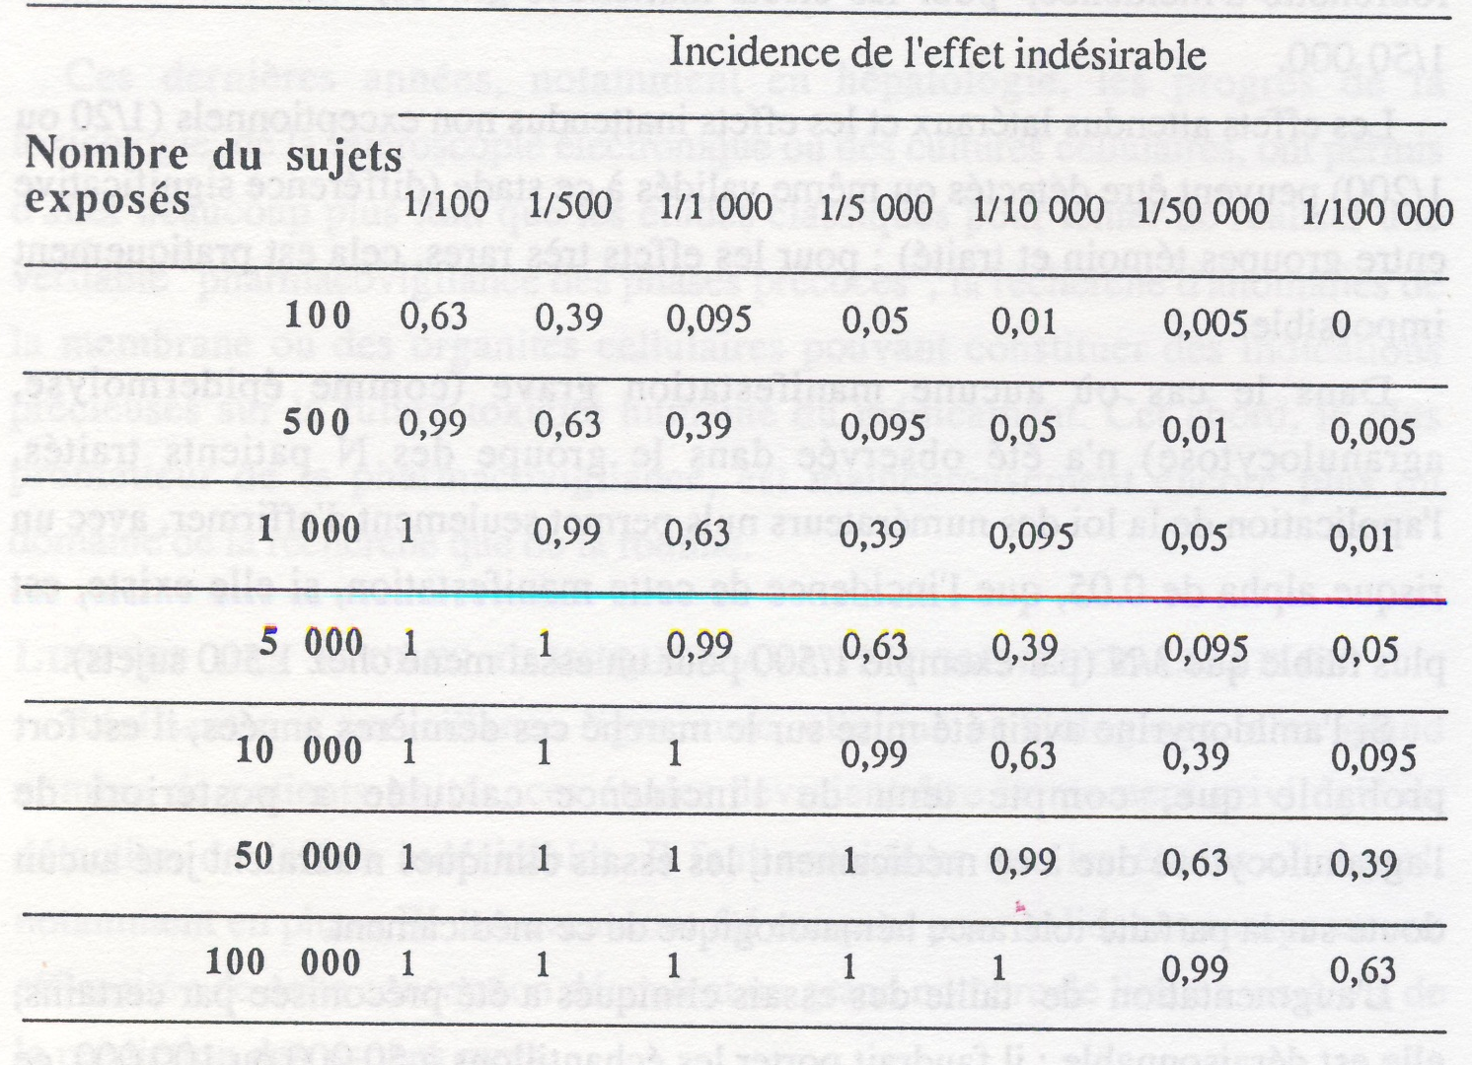
Extrapolation of safety results :
Quantitative representativity limits ?
To detect surely an adverse event, it is needed ten times more than the reverse ratio of the frequency of the adverse event
30

Slide 31
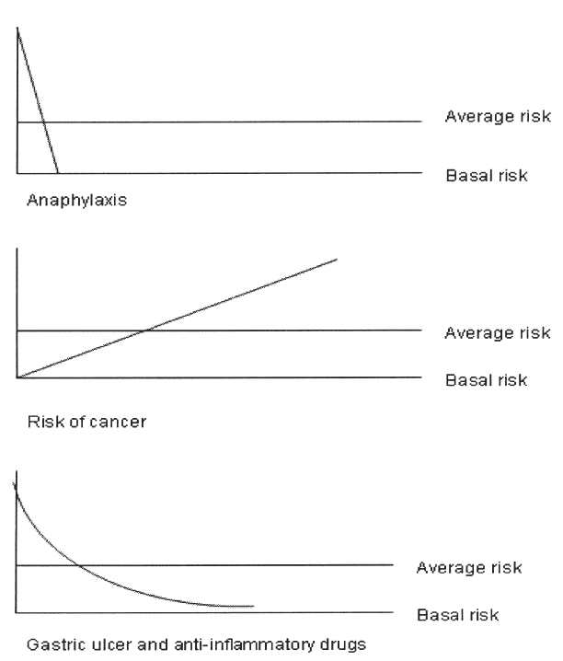
Extrapolation of safety results :
Limits in time to event ?
The time to adverse events can often be much longer than the duration of patient inclusion
This means that :
- Most of long terms AE won’t be screened by clinical trials
- Short terms AE are overrepresented
Y. YAZICI : Some concerns about Adverse Event reporting in
randomized clinical trials. Bulletin of the NYU Hospital for Joint
Diseases. 2008, 66(2) : 143 - 145
Notes:
PENSER A RAPPELER QUE L4INCLUSION DEMARRE DES La SIGNATURE DU CONSENTEMENT

Slide 32
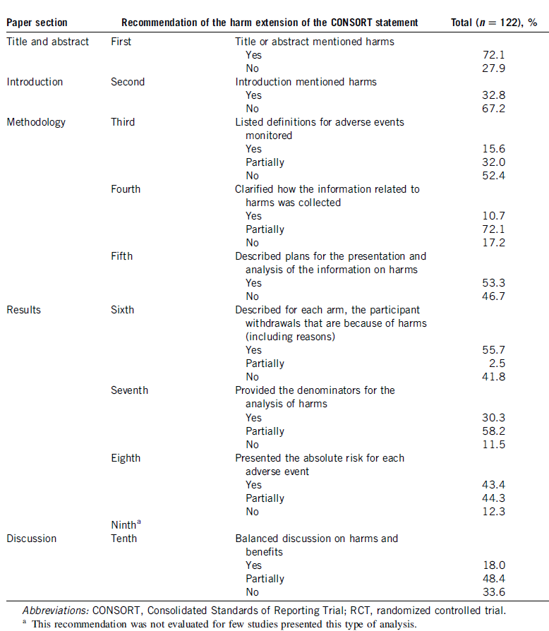
Extrapolation of safety results :
Limits in publications ?
Review of 122 studies published in
2009 in BMJ, JAMA, NEJM and The
Lancet :
- Safety is often announced in the
title or in the abstract,
But less presented in results and withdrawls,
- And much less discussed in the
benefit ratio assessment.
Predectibility is more easy for efficacy than safety
C.B. MAGGI et al : Adverse events reported in randomized clinical trials of drug therapies: the information is still insufficient.
Journal of Clinical Epidemiology, 66 (2013) : 802 - 807

Slide 33
Extrapolation of safety results :
A Paradox ?
 | Clinical development | Post Marketing experience
Medical follow-up quality | +++ | +
Representativity | + | +++
Dedicated studies to safety (main criteria) and studies in real conditions of use
Post marketing pharmacovigilance
Risk Management Plans

Slide 34
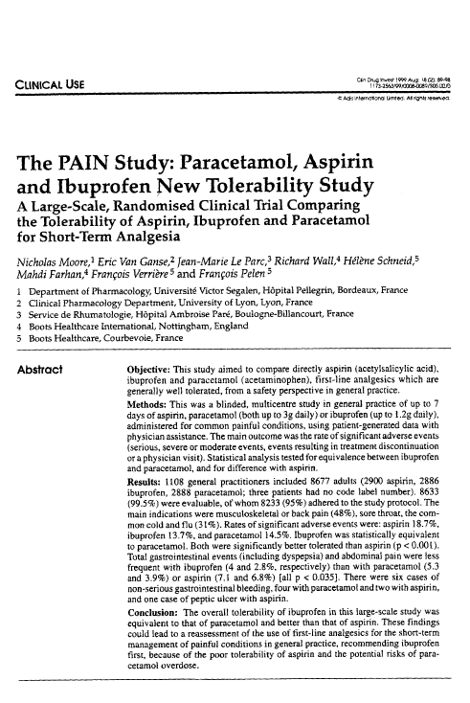
Studies dedicated to safety :
One example to assess safety ?
Paracetamol 3g/J 2888 patients
Aspirin 3g/J 2900 patients
Ibuprofen 1,2g/J 2886 patients
Primary outcome = % of patient with at least one significant adverse event
Statistical hypothesis on main criteria :
  - Ibuprofen > Aspirin
  - Ibuprofen = Paracetamol
A = 18.7%
I > A (p<0.001)
P > A (p<0.001)
I = P : equivalence
I = 13.7%
P = 15.5%
34
N. MOORE et al. The PAIN study : Paracetamol, Aspirin and Ibuprofen New Tolerability Study. A large scale randomized
clinical trial comparing tolerability of Aspirin, Ibuprofen and Paracetamol in analgesia. Clinical Drug Investigation, 1999, 18(2) : 89 - 98

Slide 35
Postmarketing pharmacovigilance :
How to move towards prevention ?
Patient exposure
Adverse events
-
Safety data collection and data processing
Safety / Risk
virtuous circle
Medical assessment and signal detection
PSURs and Immediate declarations
Risk management and prevention

Slide 36
Risk Management Plans :
How to anticipate the risks ?
Pharmacovigilance = signal detections / alerts
Risk management :
Risks already identified in patients exposed to treatment during the development period
Potential Risks (not still identified) :
  Population not exposed (i.e. children, pregnant women…)
  Use of treatment in real conditions instead of medical follow up during the development period
  Off label use (doses, contra-indications…)
Preventive actions planned by the Sponsor :
  Further safety studies / surveys
  Patients and doctors information (Promotion of safe and proper use of medicines)
36

Slide 37
Side effects during clinical trials
Conclusions :
- Safety of the patient during clinical studies involves different stakeholders, but the Sponsor has always the ultimate responsability
Individual patient’s protection must always prevails on collective interest
- Early detection, medical follow up and assessment cannot compense low representativity of clinical development phase
- Supportive predictibility of safety in clinical trials must be confirmed by risk management plans
37

Slide 38
TRACKING DRUG SIDE EFFECTS
DURING CLINICAL TRIALS
Pharmaceutical industry in Pharmacovigilance management during clinical development period :
A full role in public health
Thank you for your attention !

