Slide 1
WHO Programme for International
Drug Monitoring
UMC perspective on Kazakhstan and other member-countries in the region
Nadja Jastrebova
Pharmacovigilance Consulting
Global Services Section

Slide 2
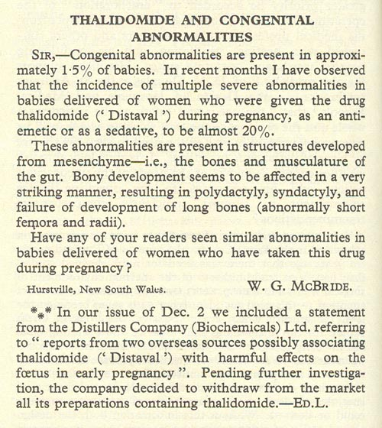
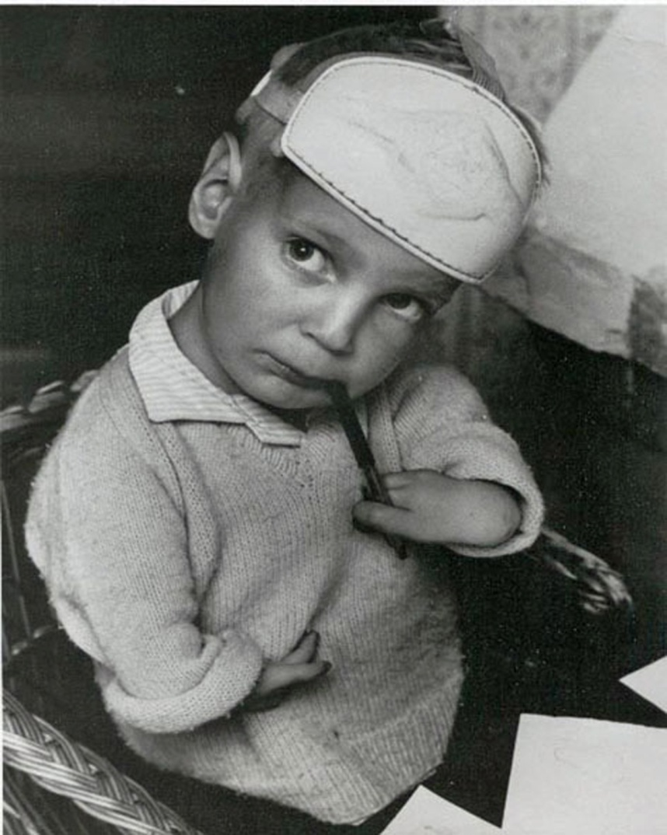
Thalidomide - phocomelia
Notes:
Pharmacovigilance is a quite new science that was established as a result of the thalidomide tragedy in the 1960s. Thalidomide was launched as a sedative in 1957 but was widely used off-label for morning sickness in pregnant women. An alert doctor named McBride observed an increase in birth defects and raised suspicion of a connection with the drug.
He published his observation in The Lancet and you could say that this was the first Adverse Drug Reaction report. The birth defects caused by thalidomide are called phocomelia which means limbs like a seal. The Swedish author Nadja Yllner has written an excellent book about the thalidomide disaster and the children who were victims of this tragedy.
Thalidomide was obviously withdrawn from the market but in spite of its teratogenicity, it was re-launched in 1999 for treatment of some skin disorders. As a consequence, female patients are monitored carefully and need to use two methods of contraceptives. Unfortunately, new cases of phocomelia have been reported.

Slide 3
WHO Drug Monitoring Programme
Founding Members (1968)
Notes:
In addition to the national collection of patient safety data it is important for countries to share the data with the rest of the world. Rare ADRs or safety concerns may not be statistically significant in one country but if data from many countries is put together, it may be identified.
The WHO Programme for International Drug Monitoring was founded by 10 countries in 1968, as a result of the thalidomide tragedy. It started out as a pilot project in the US, moved to Switzerland for a few years and ended up in Uppsala in 1978.

Slide 4
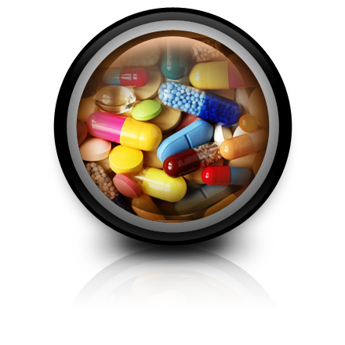
PV today
Adverse reactions
Inadequate/incorrect use
Product quality problems
Other safety challenges
Notes:
Nowadays, the scope of PHARMACOVIGILANCE has been extended to also include other safety issues than only Adverse Drug Reactions,
for example incorrect use of medicines including Medication errors; Dependence, abuse and poisoning; Antibiotic resistance
antibiotic resistance which is a major threat to global health.
Another problem area is quality defects of medicines: Failing GMP; Lack of efficacy; SSFFC medical products
and one example in this category is counterfeit drugs or SSFFC medical products which stands for substandard, spurious, falsely labelled, falsified and counterfeit.
Another example of an important PHARMACOVIGILANCE area is Immunization programmes and other public health programmes where it is common to expose large populations to new drugs with incomplete safety profiles.

Slide 5
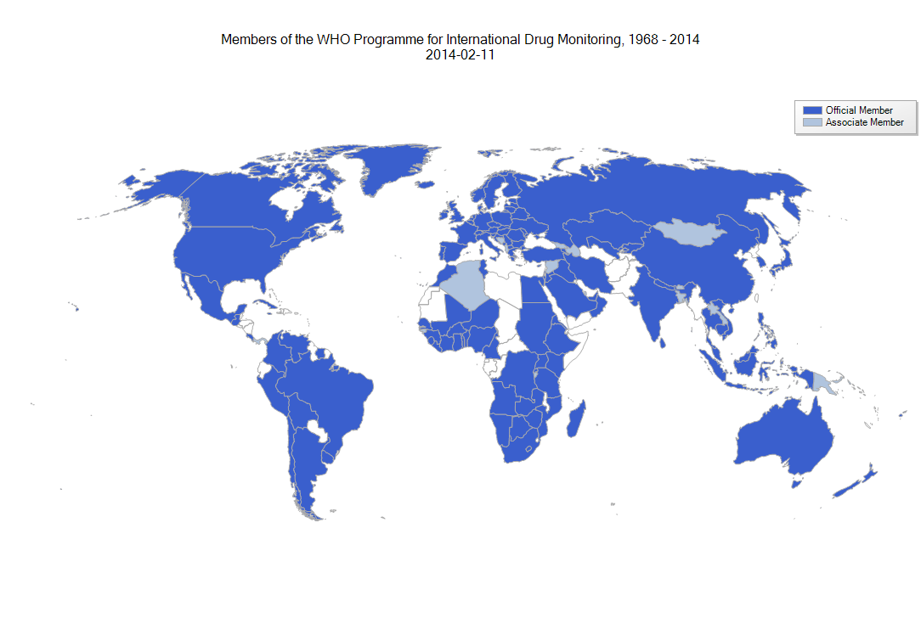
Official and associate member countries (2014)
Notes:
Программа ВОЗ по международному мониторингу лекарственных средств была создана в 1968 году в результате так называемой талидомидовой трагедии.
До этого стихийного бедствия, общее мнение об употреблении ЛС было только положительное. Никаких негативных эффектов не ожидалось.
Цель программы ВОЗ было обеспечить, чтобы первые признаки ранее неизвестных проблем связанных с безопасностью ЛС, были идентифицированы и информация о них распростронена и привела к соответственным действиям по всему миру.
10 стран участвовали в программе вначале. Пробный проект в США, 1968-1970. Работа переносится в ВОЗ, 1971-1975. Из-за проблем с финансированием в 1975 программа переносится в Швецию. Программа ВОЗ по международному мониторингу лекарств превратилась в глобальную сеть центров фармаконадзора в более чем 140 странах по всему миру.
Февраль 2014: 117 официальных стран-членов и 28 ассоциированных членов. To join the WHO Programme, countries need to have a pharmacovigilance system in place,
a National Centre designated by the Ministry of Health and technical competence to fulfill WHO reporting requirements.
Синий: Официальный страна-член: подал заявку на членство в штаб-квартиру ВОЗ в Женеве + прислали нам отчеты (минимум 20, а затем регулярно)
Голубой: Ассоциированный страна-член: подал заявку на членство в штаб-квартиру ВОЗ в Женеве, но НЕ присылали нам еще сообщения
Population coverage:
88,6% official members
3,9% associate members
7,5% not members

Slide 6
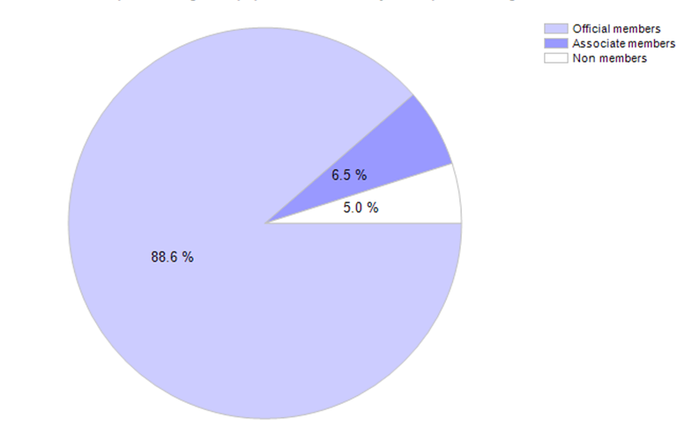
Population coverage
Notes:
Another way of presenting the amplitude of the Programme is to look at the population covered. Only 5% of the world population is still not included in the Programme but hopefully one day all countries will take part.

Slide 7
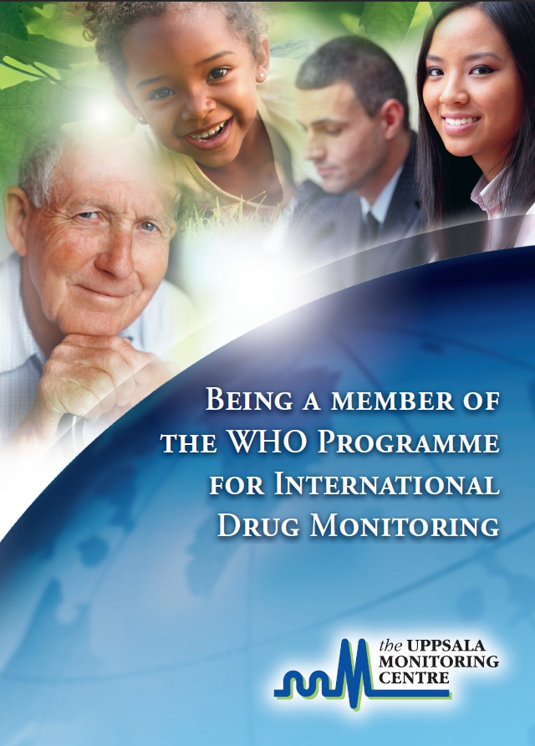
Member obligations
Send high quality ICSRs frequently
Actively participate in the WHO Programme
Being a member of the WHO Medicines Safety Programme

Slide 8
WHO International PV Programme
WHO-CC
Ghana
UMC-A
WHO-CC
Morocco
CAPM
WHO-CC
Netherlands
Lareb
WHO-CC
Sweden
UMC
WHO-HQ
Geneva
National
Centres
Pharma
industry
Healthcare
Patients
(directly)
Patient safety data
Notes:
Make doctors understand how their activity is connected to the WHO and that their contribution is critical. We are unable to do anything if they don’t produce any ADR reports in the first place. The programme is funded by the WHO-DD license agreements for pharma companies and CROs.
Now, when WHO and UMC have been introduced, it is time to look at the other players in the PHARMACOVIGILANCE arena.
There are a few other WHO Collaborating Centres in PHARMACOVIGILANCE; One in Ghana responsible for training and advocacy, primarily for English speaking African countries. Another in Morocco responsible for training for Francophone, Eastern Mediterranean and Arabic countries. They also work with medication errors. The third one is in the Netherlands, responsible for developing a PHARMACOVIGILANCE curriculum for universities as well as working with direct patient reporting.
The most important players in the Programme are the National Centres since they collect the data and send it to UMC.
The National Centres collect data from healthcare,
from patients directly and
from the pharma industry.
UMC does not accept ICSRs from any other source than National Centres.

Slide 9
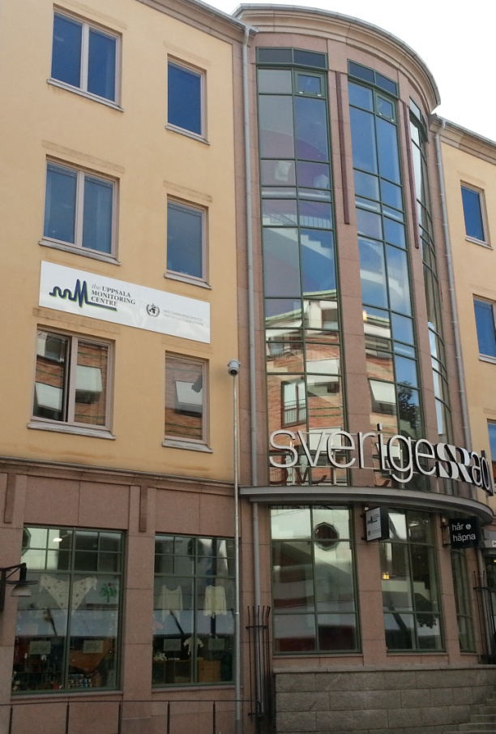
UMC - WHO Collaborating Centre for International Drug Monitoring
the Uppsala Monitoring Centre
Established as a foundation 1978
Agreement between Sweden and WHO
WHO-HQ responsible for policy issues
International administrative board
Self financing
Notes:
the Uppsala Monitoring Centre (the UMC) is the field-name of the WHO Collaborating Centre for International Drug Monitoring.
UMC ведет программу, но ВОЗ несет ответственность за политические вопросы.
Создан как учреждения 1978; На основании соглашения между правительством Швеции и ВОЗ
Оперативный центр программы ВОЗ по международному мониторингу лекарственных средств
Штаб-квартира ВОЗ несет ответственность за политические вопросы; Международное административное управление (3 от шведского государства и 3 ВОЗ); Самофинансирующее бесприбыльное учреждение
UMC не получает финансирование от правительства Швеции и ВОЗ.Выживание программы ВОЗ зависит полностью от дохода, полученного от нашей собственной коммерческой деятельности. WHO-DD словарь/база данных ЛС является нашим основным доходом.
100 employees

Slide 10
UMC’s vision and main tasks
Improve worldwide patient safety and welfare by reducing the risk of medicines
Collect and analyse
individual case safety reports (ICSRs) worldwide
Communicate potential
patient safety issues
Actively support and provide training in Pharmacovigilance
Develop the science of Pharmacovigilance
Notes:
Собирать и анализировать ICSRs со всего мира;
Информировать о потенциальных проблемах безопасности лекарств
Активно поддерживать и обеспечивать профессиональную подготовку;
Развивать науку фармаконадзора

Slide 11
VigiBase® WHO global ICSR database
The oldest and largest global ICSR database
Used for global and country specific signal detection
Free to search in by National Centres of member countries
Customized searches are performed on request from companies and other interested
Notes:
VigiBase: Vigibase это название глобальной базы данных НПР ВОЗ.
* The source of worldwide post-marketing individual case safety reports (ICSRs)
* VigiBase data is freely accessible to all WHO programme member countries and can be accessed indirectly by other regulatory bodies like the pharmaceutical industry, academia, etc

Slide 12
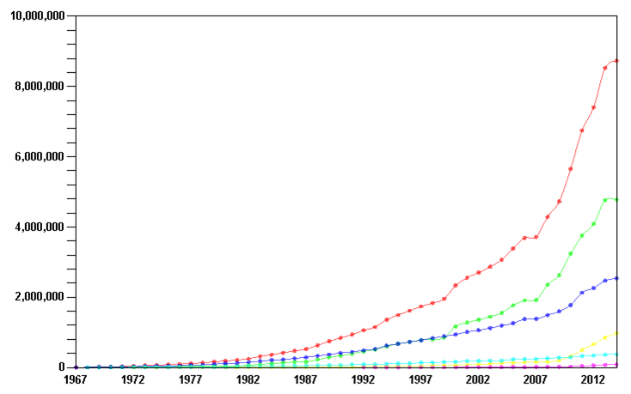
VigiBase® and report accumulation
Total
Americas
Europe
Asia
Oceania
Africa
Notes:
VigiBase: Vigibase это название глобальной базы данных НПР ВОЗ. Там находятся больше 8 миллионов сообщений, собранных с 1968.
CIS составляют около 6.000 сообщений (0,07%)

Slide 13
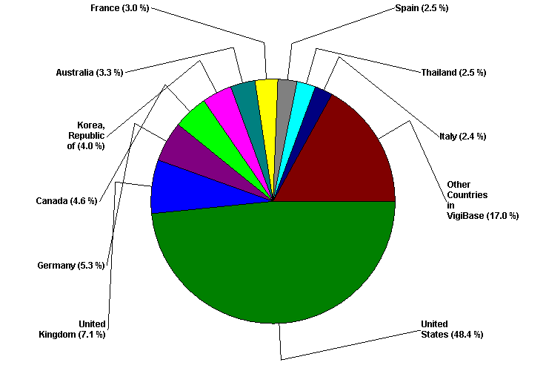

Slide 14
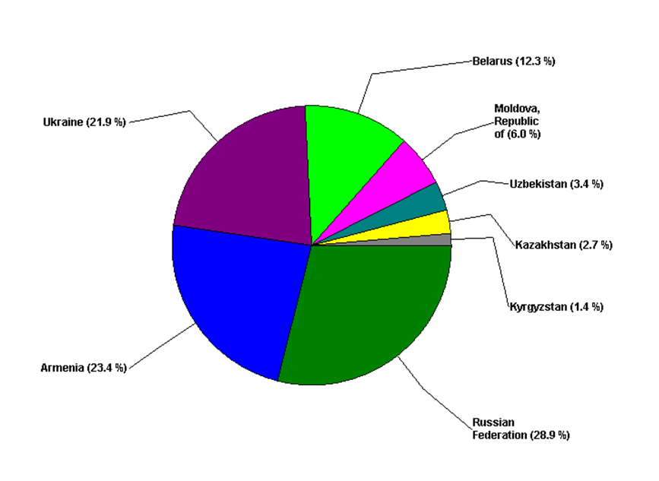
6.000 ICSRs
Population
9.500.000
45.600.000
3.600.000
29.800.000
16.800.000
5.600.000
2.900.000
143.500.000
Notes:
Russian Federation INTDIS 1 684
Armenia VigiFlow 1 361
Ukraine VigiFlow 1 275
Belarus E2B 715
Moldova VigiFlow 349
Uzbekistan VigiFlow 196
Kazakhstan VigiFlow 159
Kyrgyzstan INTDIS 80
Total 5 819

Slide 15
Quality of ICSRs vigiGrade - Completeness Score
Way of measuring the amount of information on ICSRs
Calculated from 8 parameters important for analysis:
Type of report
Primary source
Gender
Age at onset
Time to onset
Indication
Outcome
Free text
Notes:
The UMC has developed a system to measure the information provided on ICSRs. Completeness score.
(“Documentation Grading Completness Score”)
Each report receives a score from 0 to 1

Slide 16
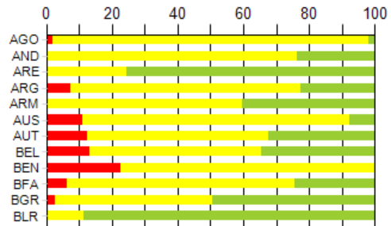


Quality of ICSRs
vigiGrade - Completeness Score
%
Countries
Notes:
We want all countries to have green bars.
Calculated on all ICSRs entered into the WHO global ICSR database between 20090101 and 20140327
16

Slide 17
Notes:
2013. Average Completeness vs number of ICSRs/million inhabitants. Colour indicate region, bubble size indicate number of submissions.
ASEAN: Association of Southeast Asian Nations
EMRO: Eastern Mediterranean Regional Office

Slide 18
Reporting format
UMC
Country A
Country C
สวัสดี
hari yang baik
Country B
يوم جيد
Notes:
Thai
Arabic
Malaysian

Slide 19



Reporting format and harmonization – E2B
Country A
UMC
Country C
E2B
E2B
Country B
E2B
Notes:
Internationally agreed message standard for transfer of electronic ICSRs.

Slide 20
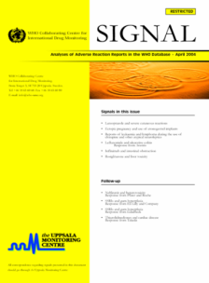
Signal detection
Periodic screening of VigiBase data
Manual review of literature and ICSRs
Clinical assessment by international expert panel
Publication/communication to National Centres
UMC is not a regulatory body

Slide 21
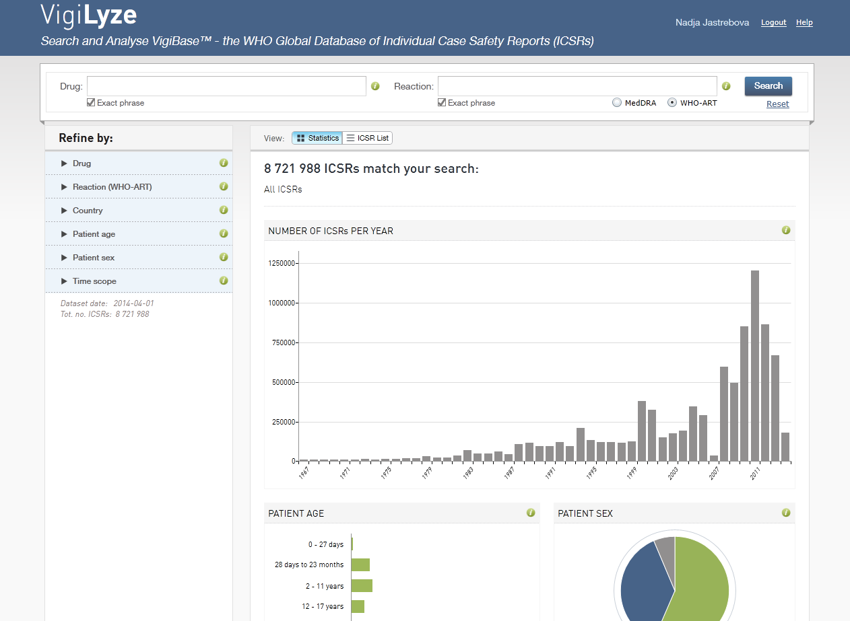

Slide 22
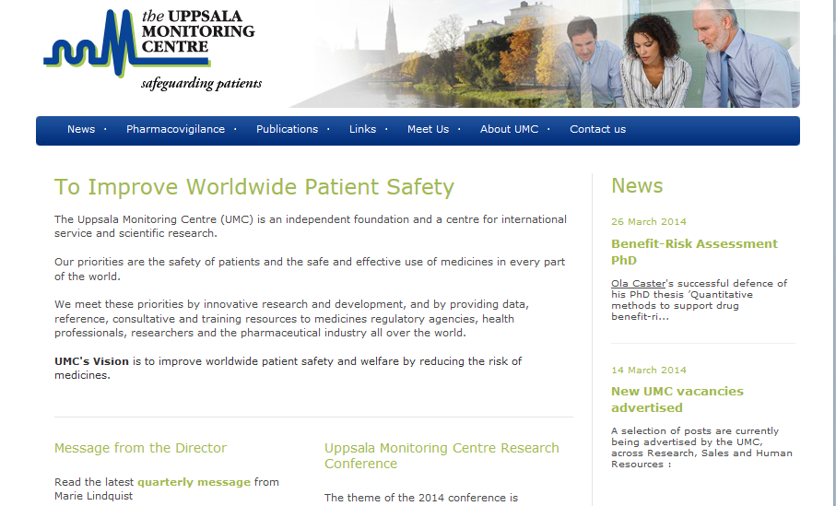
http://www.who-umc.org
Notes:
Our new website!

Slide 23
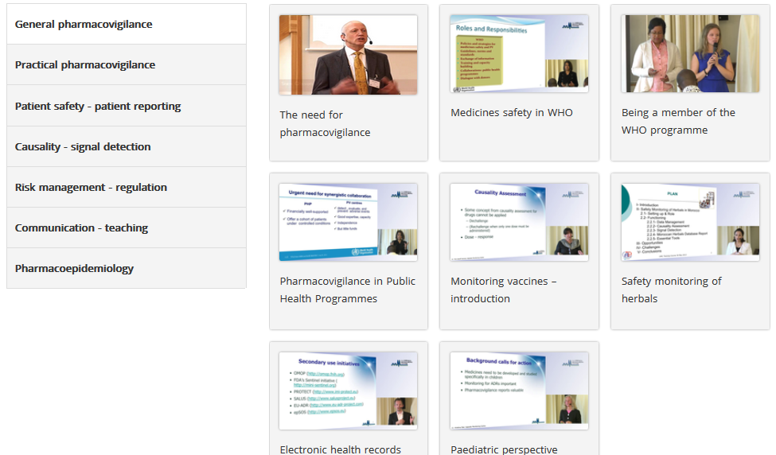
Training
43 Web lectures from UMC PV Courses
Notes:
UMC staff has started to use virtual training methods to a greater extent. General PV support as well as specific training sessions has been provided to several countries via GoToMeeting, GoToWebinar and Skype.
Sometimes a combination of on site training and webinar e.g. Indonesia (Tova present – Anders webinar) and Peru (Elki and Gendie present - Pia webinar).
The majority of the lectures during the UMC pharmacovigilance course are recorded and freely available via a link on the UMC website in the section about pharmacovigilance - Education & Training. The video website was upgraded in 2013 in order to improve the UMC offering of training channels. Old videos were archived and the remaining videos were divided in different categories to make the website more user friendly. All lectures have pdf hand-outs attached, some also translated into Spanish.

Slide 24
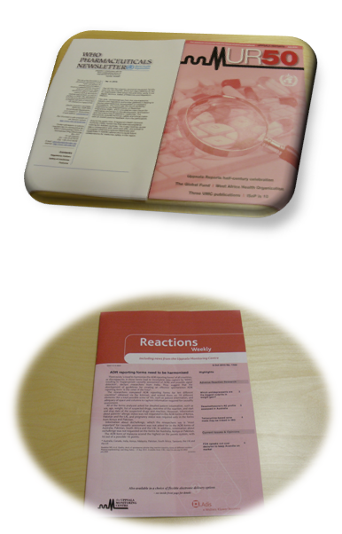
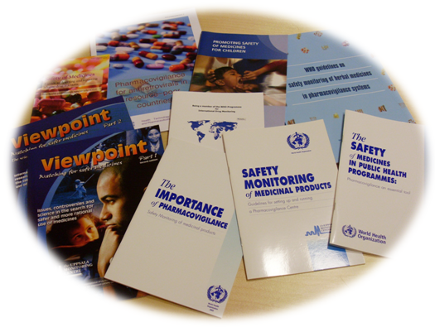
Publications
Notes:
The WHO-PHN has six issues per year and contains drug safety information provided by National Centres, mainly regulatory decisions. It also contains UMC signals.
The news bulletin to the right on this slide is Uppsala Reports published by UMC. It has 4 issues per year and contains information about PHARMACOVIGILANCE activities, projects and courses around the world. It is distributed free of charge to anyone who is interested.

Slide 25
Thank you for your attention!
Nadja.Jastrebova@who-umc.org

Slide 26
Quality vs. quantity
Notes:
2013. Average Completeness vs number of ICSRs/million inhabitants. Colour indicate region, bubble size indicate number of submissions.
ASEAN: Association of Southeast Asian Nations
EMRO: Eastern Mediterranean Regional Office

Slide 27
Quality vs. quantity
4 + Enter to see non-European countries
Notes:
2013. Average Completeness vs number of ICSRs/million inhabitants. Colour indicate region, bubble size indicate number of submissions.

